Slide 1

Exoplanet Transit Analysis
Project 4 by Cosmo Lei, Haechan Jung, Yuhang Mao

Slide 2
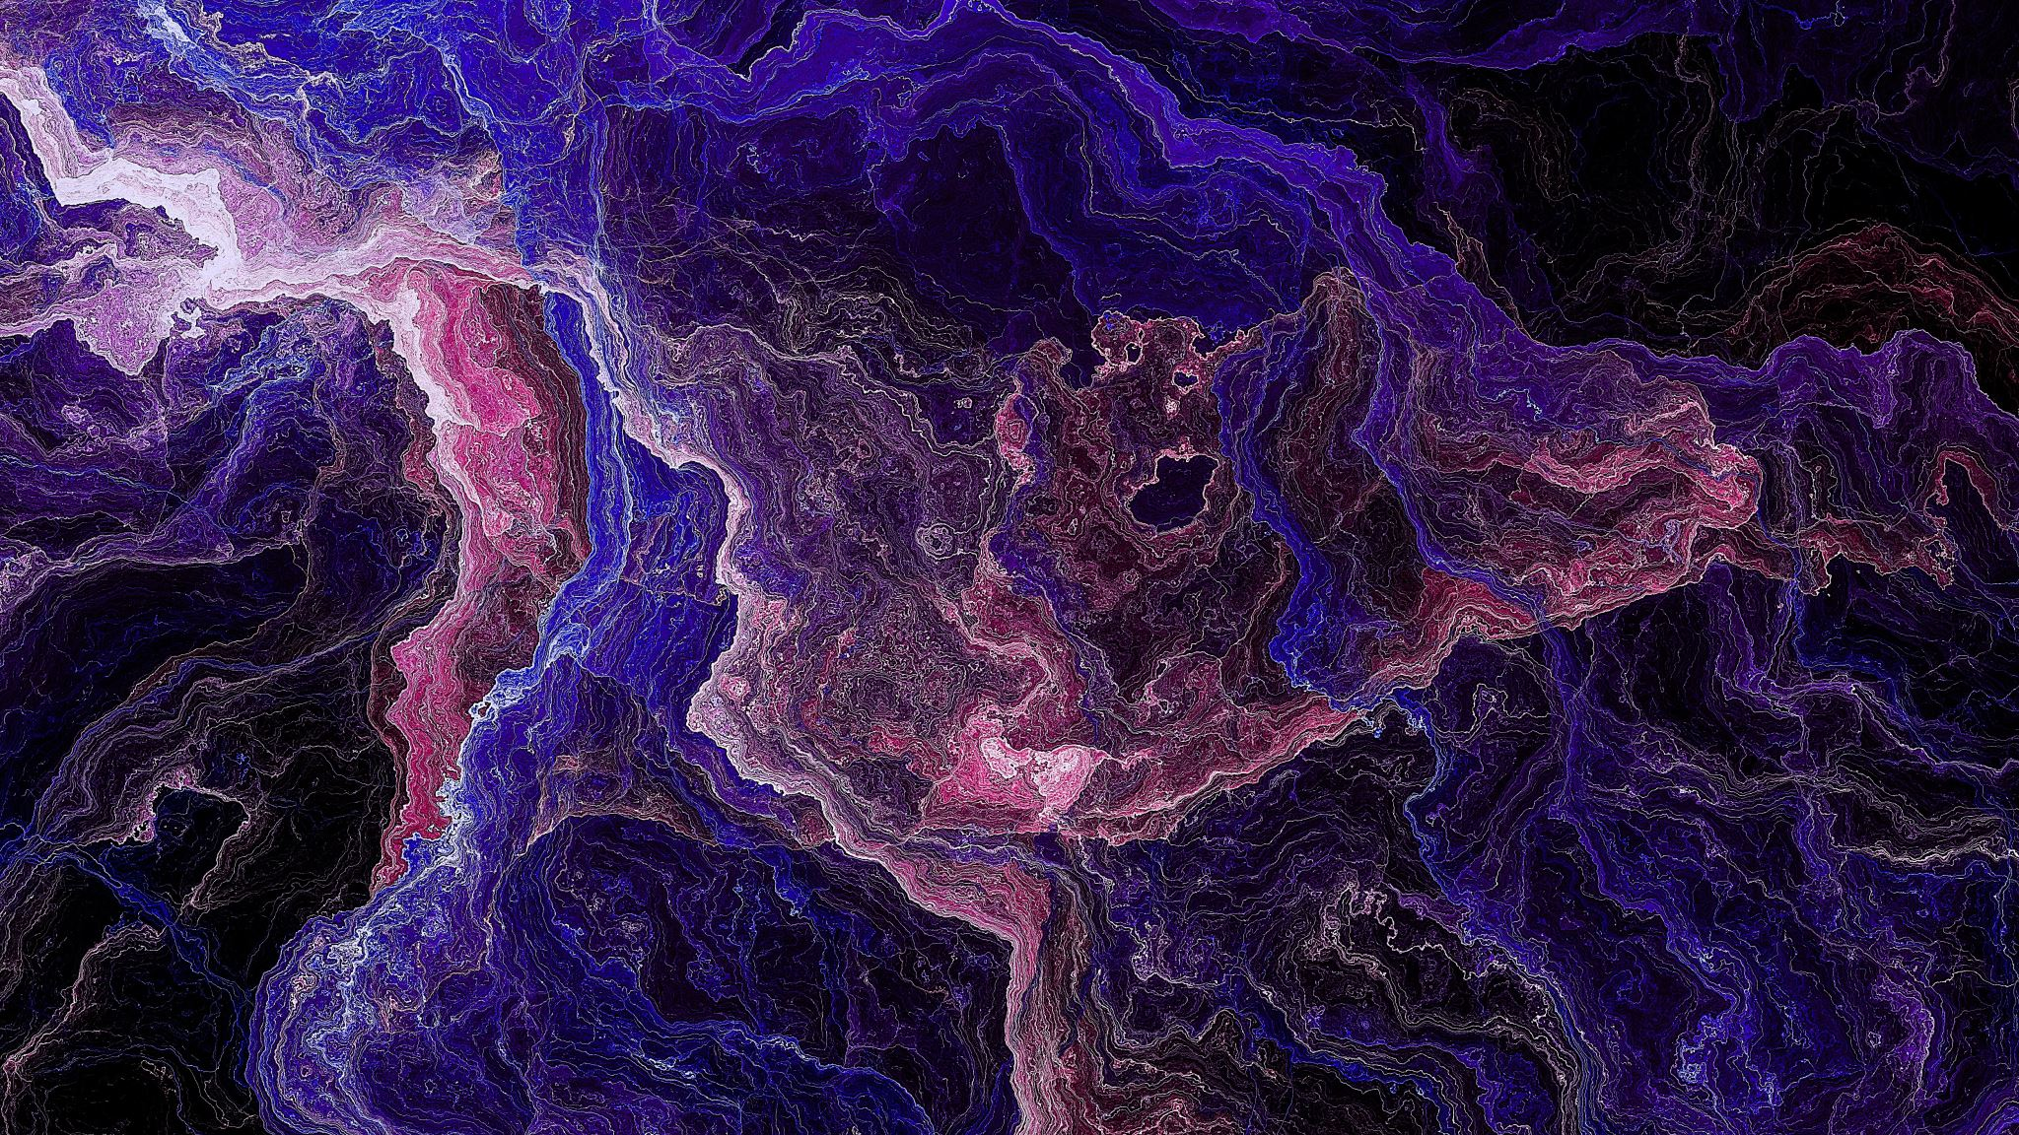
Background

Slide 3
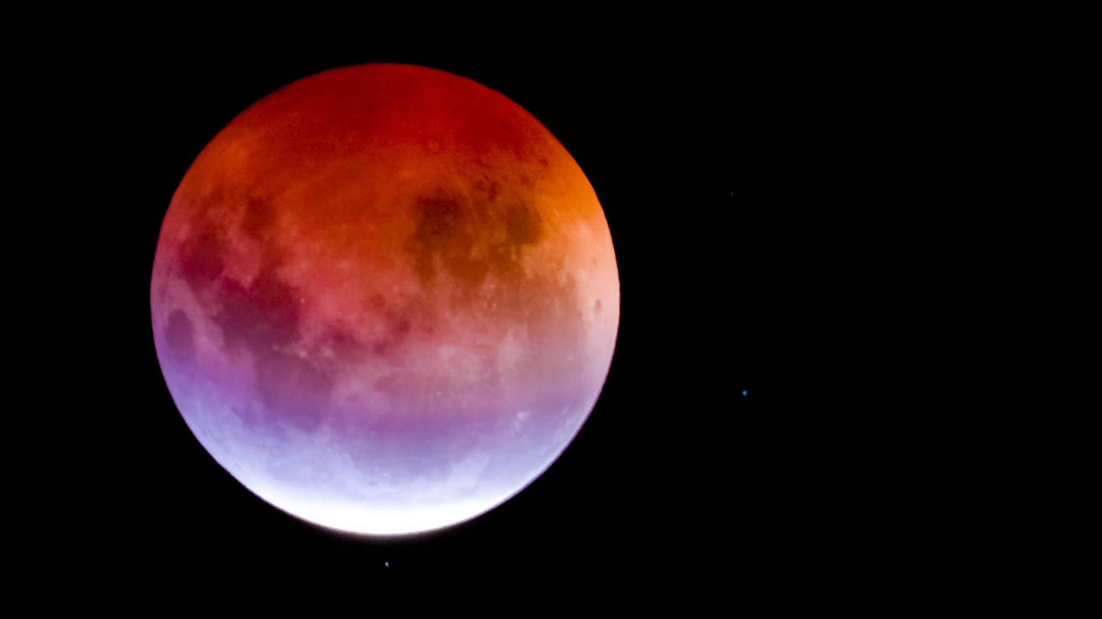
Background
The study of exoplanets, planets located outside our solar system, is a rapidly advancing field in astronomy. Among various methods of exoplanet detection, the transit method has proven to be one of the most effective. This method involves observing the periodic dimming of a star as a planet passes in front of it, blocking a fraction of the starlight. The dimming produces a characteristic light curve, revealing critical information about the planet’s size, orbital period, and distance from the star.

Slide 4

Objectives

Slide 5
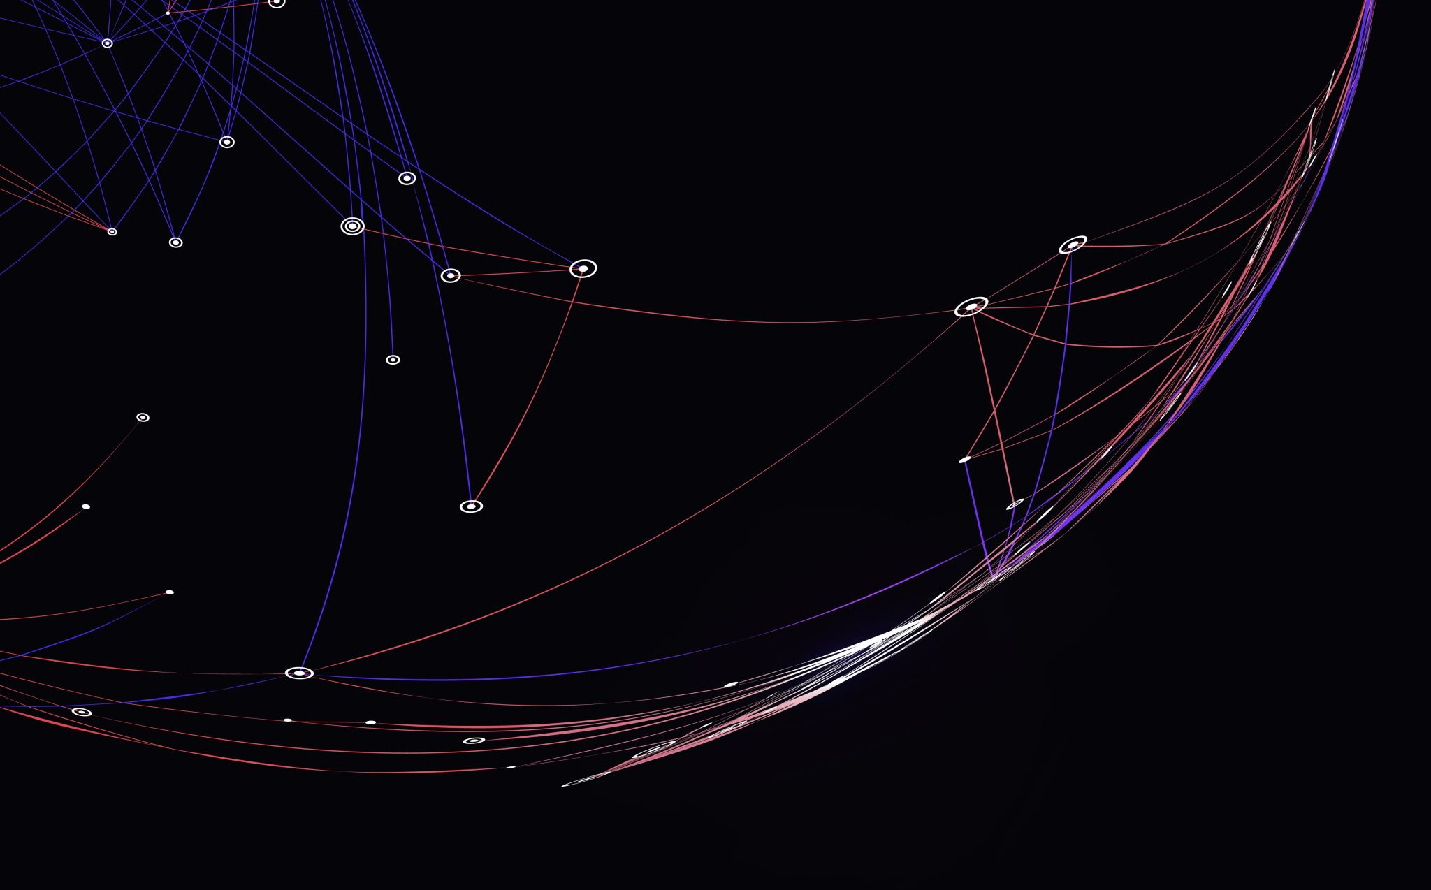
Objectives
1. To process and analyze observational light curve data of an exoplanet transit.
2. To develop and implement mathematical models (box-shaped and trapezoid-shaped) to fit the light curve data.
3. To estimate the physical parameters of the exoplanet, including transit depth, duration, ingress/egress time, and background flux.
4. To assess the quality of the model fit using statistical methods such as the reduced chi-squared statistic .

Slide 6

Implementation

Slide 7
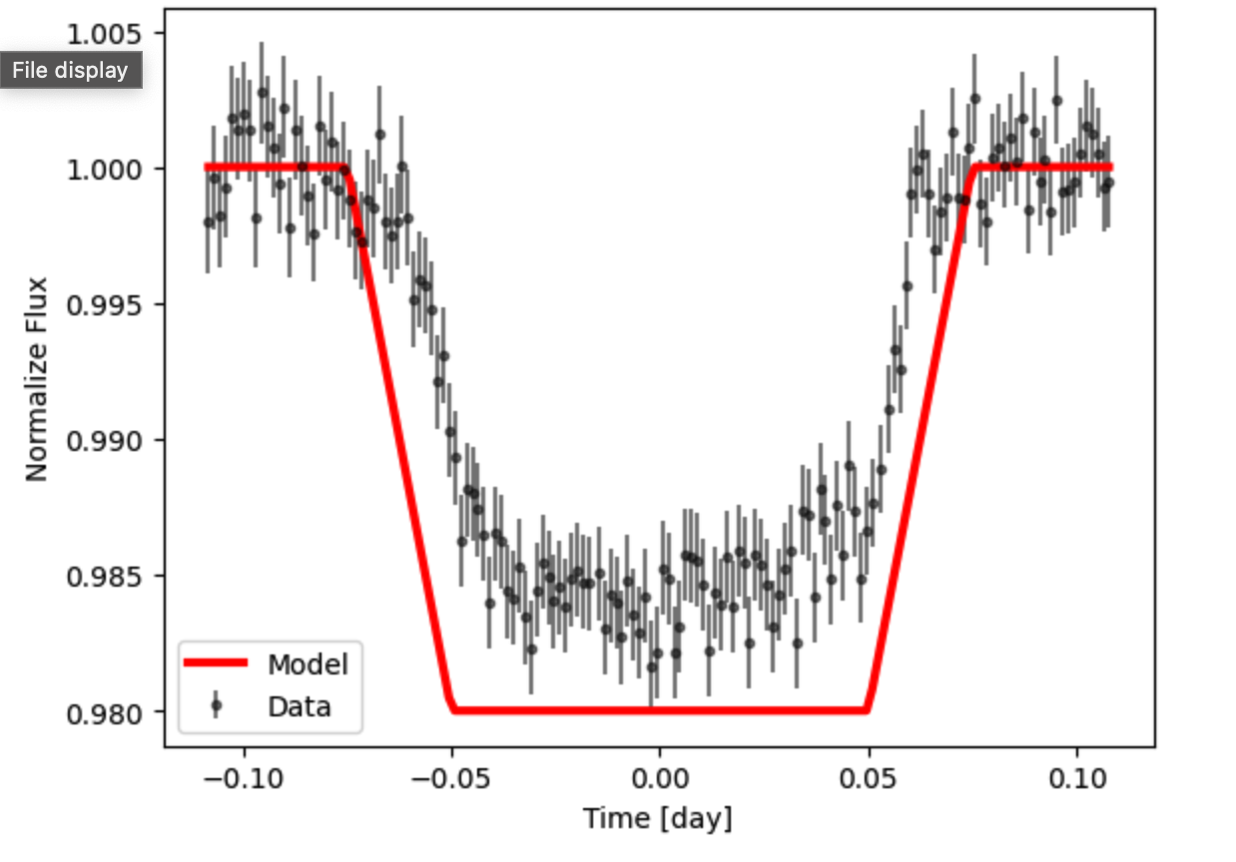
Step 1
Import the data and plot the light curve of the planetary transit. We can see that the light curve has a distinct depression. We fit the light curve with the red line segment.

Slide 8
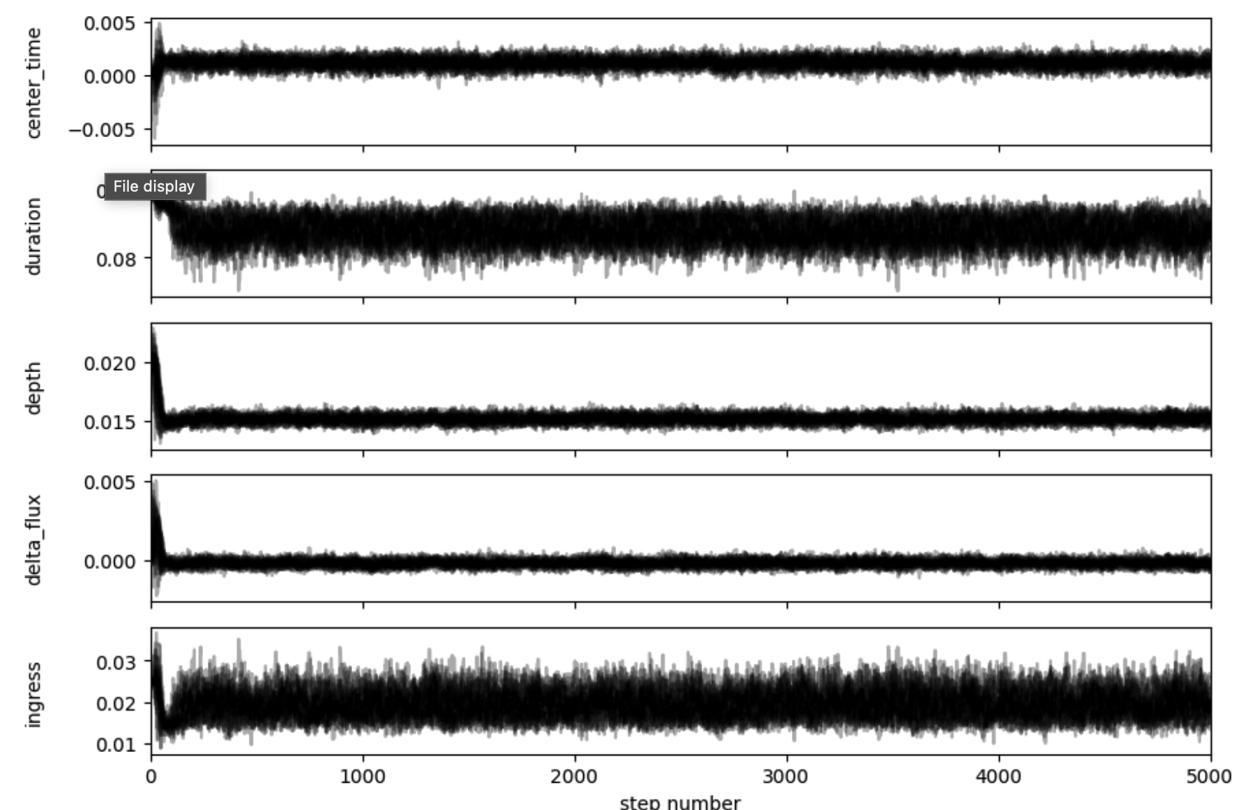
Step 2
The fitting data was sampled with MCMC. The flat sample is used to draw a corner plot, showing the distribution characteristics of the parameters and possible correlations.

Slide 9
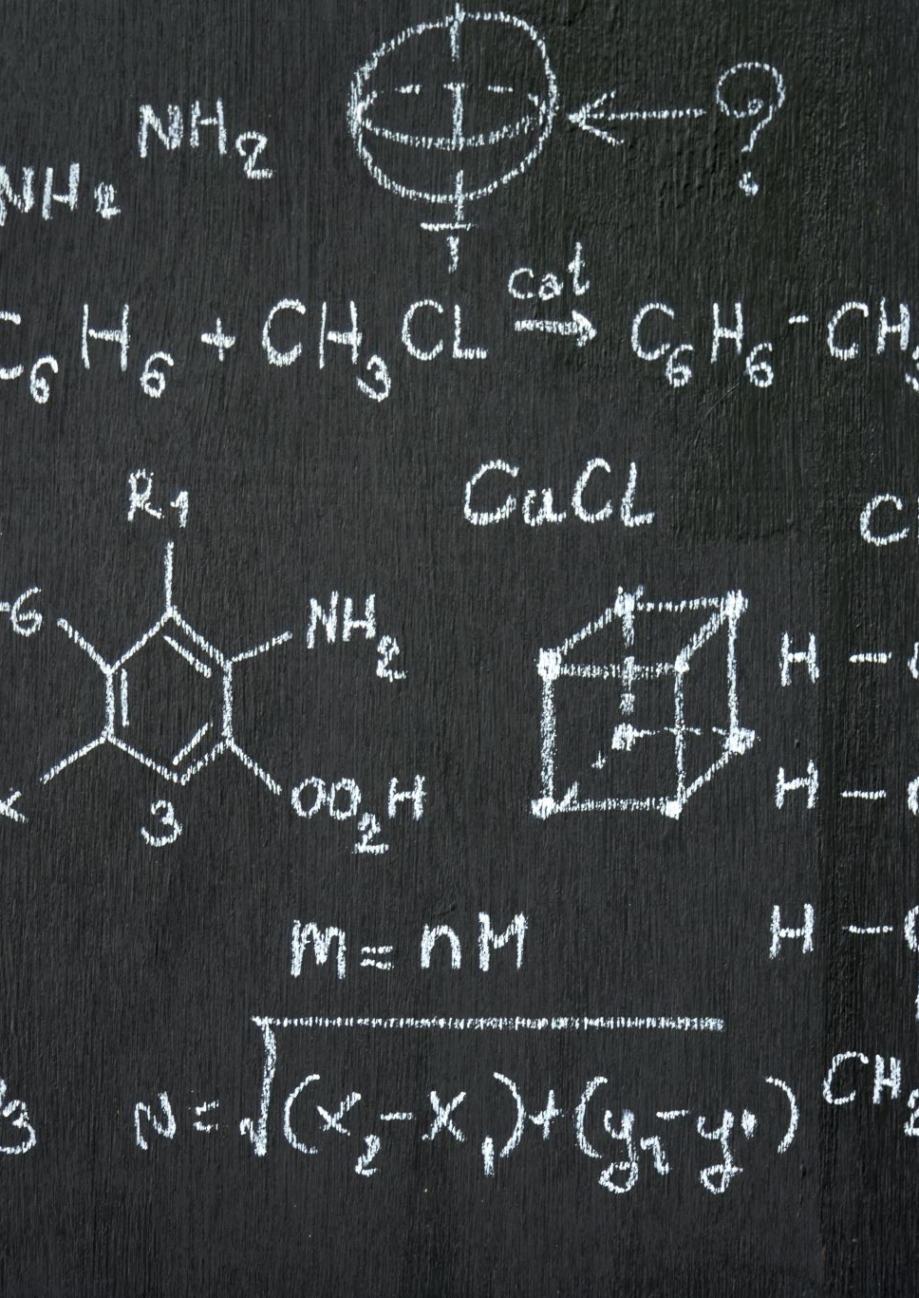
Step 3
Calculate and get the final result
Center Time:0.00117 ± 0.00047 days
Duration: 0.08772 ± 0.00097 days
Depth: 0.01515 ± 0.00033
Delta Flux:-0.00018 ± 0.00023
Ingress: 0.01950 ± 0.00057 days

Slide 10

Conclusion
This project demonstrated the power of mathematical modeling and statistical inference in analyzing exoplanet transit data. By employing a trapezoidal model and Bayesian MCMC techniques, the analysis yielded precise and physically meaningful parameters for the exoplanet. The reduced chi-squared value confirmed the accuracy of the fit, while the corner plot provided insights into parameter distributions and correlations.
Future work could involve applying the same techniques to other datasets, incorporating limb-darkening effects for more realistic models, or exploring different transit scenarios such as grazing transits or multi-planet systems. The methodology and results provide a robust foundation for advancing exoplanet studies.

